Slide 1
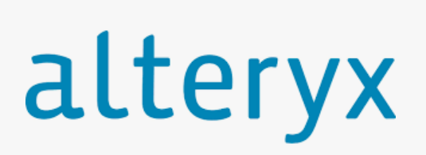
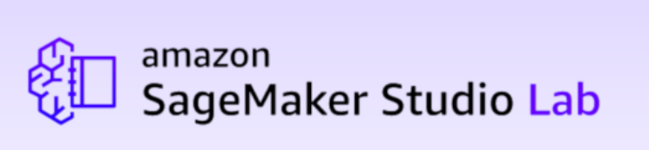

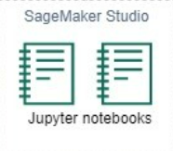
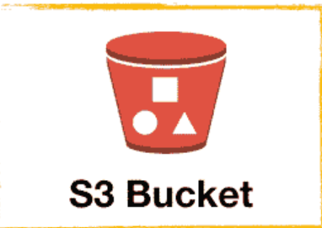
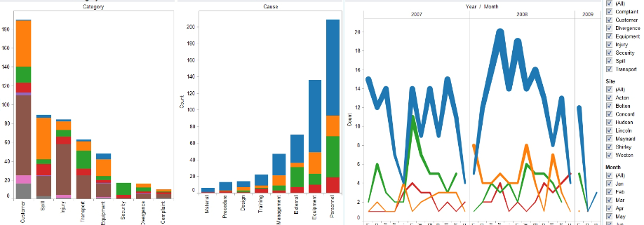
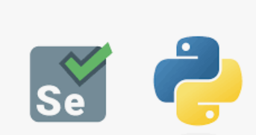
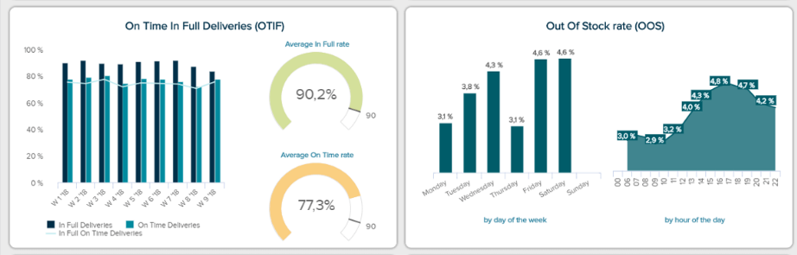

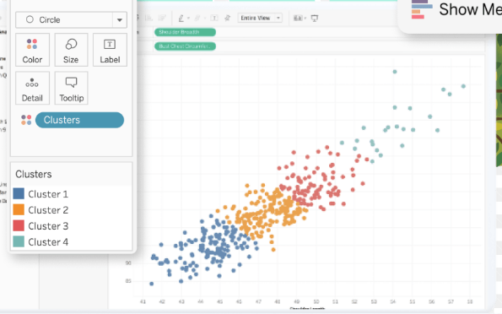
Kroger 84.51 Stratum
Kroger 84.51 Market 6
Saving Model coefficient to S3.
Running custom Algorithm
Local Storage
Feature Engineering
Preprocessing
EDA
Single Alteryx Workflow for complete selenium automation and ETL to AWS S3
The AWS Sagemaker Studio for complete pipeline, preprocessing, Feature Engineering, Model making & model deployment.
Multiple Tableau Dashboard to visualize the output from the pipeline at different steps. Various data files stored in S3 used for EDA, Model coefficient & check Waterfall values of regional model.
The Machine Learning Pipeline architecture using AWS.;

